Slide 1
Customer service enhancement Using AGENTS

Slide 2
Main task
Design a multi-agent system to improve customer service by addressing inquiries, solving problems and providing instant support through AI-driven chatbots and virtual assistants.

Slide 3
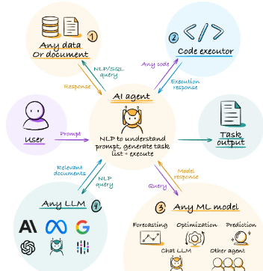
What are agents?
AI agents are software entities that use artificial intelligence to perform tasks autonomously. They perceive their environment, make decisions, and take actions to achieve specific goals, often learning and adapting over time.

Slide 4
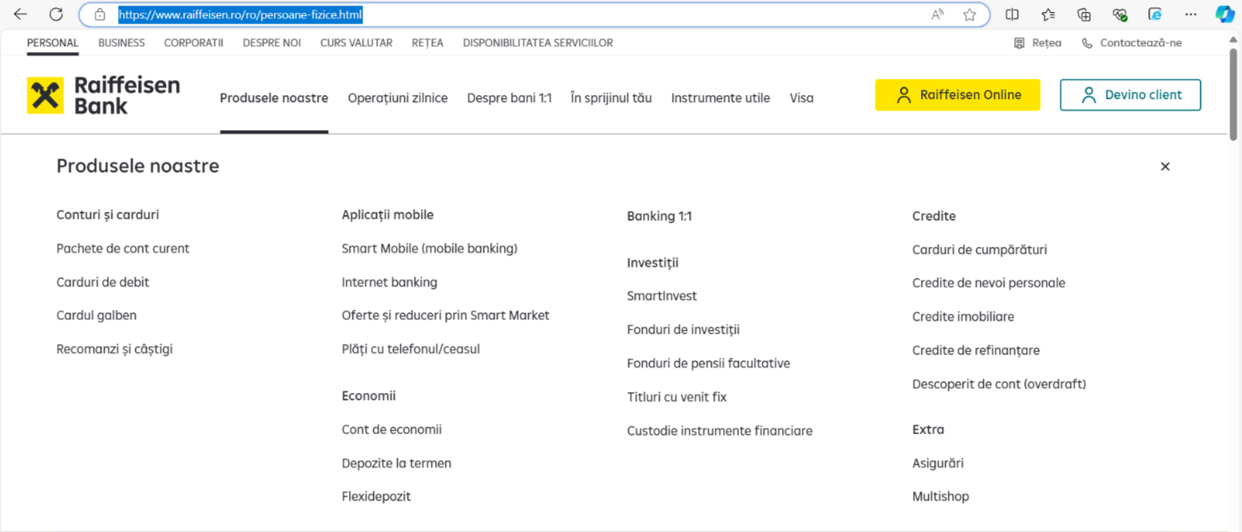
Customer service platform
Link to website: Persoane fizice

Slide 5
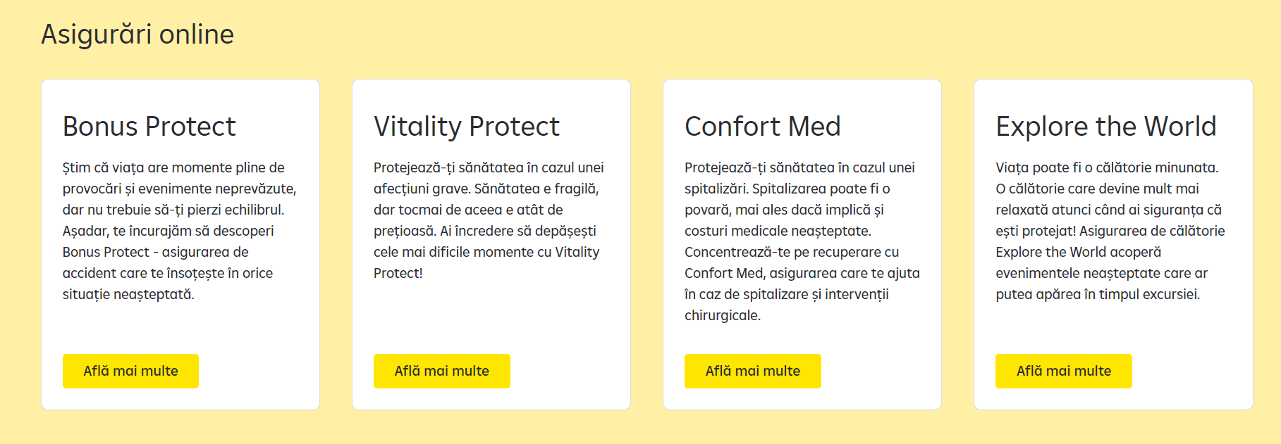
Data parser agent
Extract information from our website.

Slide 6
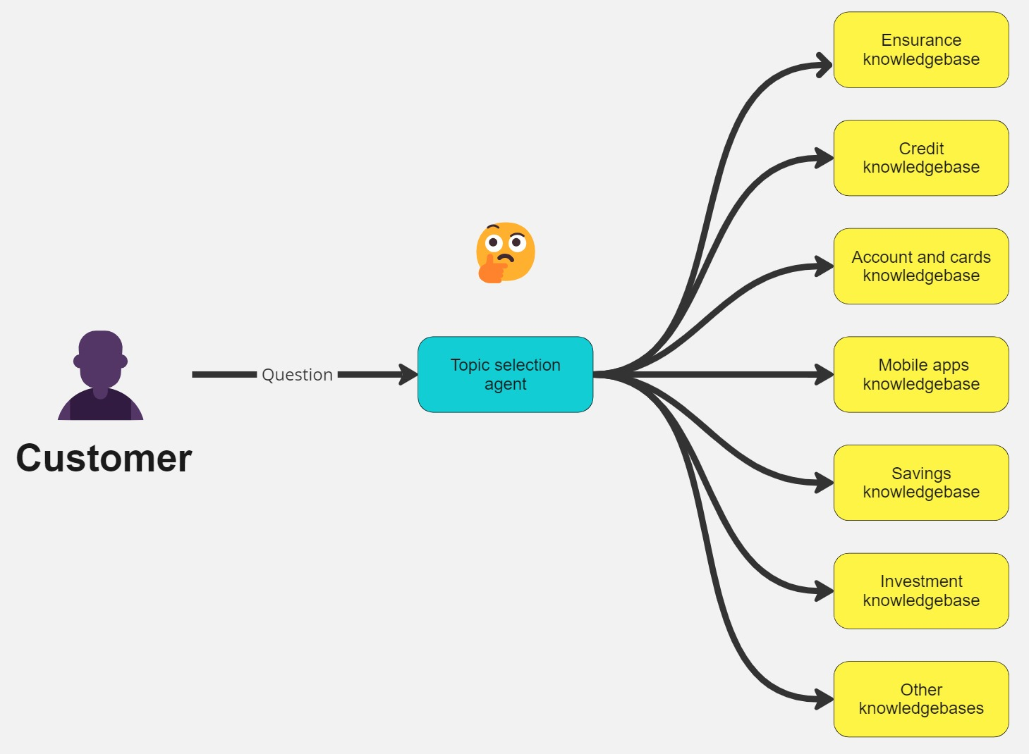
Topic selection agent
Based on user question, select the relevant topic knowledge base

Slide 7
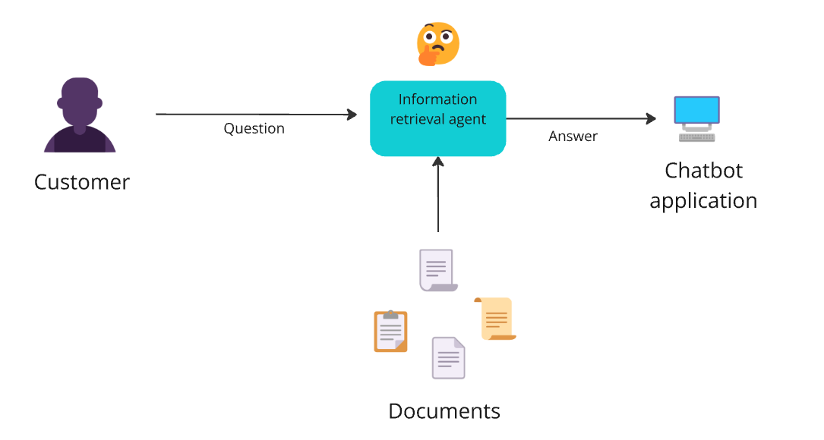
Informational retrieval agent
Can offer a response based on user question and provided information.

Slide 8
Good LUCK!

